Slide 1


SRM UNIVERSITY, ANDHRA PRADESH
Data Structures Lab Project Report
Submitted in partial fulfillment for the award of the degree in
BACHELOR OF TECHNOLOGY
IN
COMPUTER SCIENCE AND ENGINEERING
Submitted by
BEECHA VENKATA NAGA HAREESH|AP21110010839
Under the guidance of
Dr. Nitul Dutta

Slide 2
PROJECT -1 TOWER OF HANOI
By BEECHA VENKATA NAGA HAREESH
AP21110010839
UNDER THE GUIDANCE OF
DR. NITUL DUTTA

Slide 3
Description
Tower of Hanoi is a puzzle where we have three rods and n disks are placed in the first stand. We have to place discs into the third or destination stand, the second or auxiliary stand can be used as a helping stand. This is a real time game, and we use the computer program to make it simple for more discs.

Slide 4
Rules for the Tower of Hanoi
Only one disk can be move at a time.
Each move consists of taking the upper disk from the stack not the lower disk
No bigger disk should not be placed on top of a smaller disk.

Slide 5
ALGRORITHM
STEP 1: - START
STEP 2: - Initialize an integer n representing number of disks.
STEP 3: - Create 3 stacks for source, destination, and auxiliary. Similarly, Create 3 variables s as ‘A’, d as ‘B’, a as ‘C’.
STEP 4: - Check if the number of disks mod 2 is 0, store d in a temporary variable. After that, update d as a and a as temporary variable.
STEP 5: - Firstly, create a variable for the total number of moves and update it as (n*n) -1.
STEP 6: - Traverse from n to 1 and push the current value in source stack.
STEP 7: - Traverse from 1 to total moves and check if current index mod 3 is 1, pop the top from source and destination stack. If the popped top of source stack is equal to INT_MIN, push the popped top of destination to source.
STEP 8: - Else If the popped top of destination stack is equal to INT_MIN, push the popped top of source stack to destination stack.
STEP 9: - Else If the popped top of source stack is greater than the popped top of destination stack, push both the tops in source stack, else push both in destination stack. After that, print the traversal.

Slide 6
STEP 10: - Similarly, check if current index mod 3 is 2, pop the top from source, and auxiliary stack. If the popped top of source stack is equal to INT_MIN, push the popped top of the auxiliary stack to source stack.
STEP 11: - Else If the popped top of the auxiliary stack is equal to INT_MIN, push the popped top of source stack to auxiliary stack.
STEP 12: - Else If the popped top of the auxiliary stack is equal to INT_MIN, push the popped top of source stack to auxiliary stack.
STEP 13: - Similarly, check if current index mod 3 is 0, pop the top from auxiliary and destination stack. If the popped top of the auxiliary stack is equal to INT_MIN, push the popped top of destination stack to auxiliary stack.
STEP 14: - STOP

Slide 7
Time And Space Complexity
Time complexity: -
if we assume n as number of discs Then The time complexity is O(2^n), because that is the number of iterations done in the only loops present in the code, while remaining code run in constant time
Space Complexity: -
The space complexity can be split up into two parts:
The "towers" themselves (stacks) have a O(n) space complexity
The auxiliary space has a O(1) space complexity as there are no other vectors, and the call stack has a fixed size (no dynamic recursion) So the overall space complexity is O(n).

Slide 8
CODE
#include <stdio.h> // header file //
#include <math.h> // header file //
#include <stdlib.h> // header file //
#include <limits.h> // header file //
// A structure to represent a stack //
struct Stack
{
unsigned capacity;
int top;
int *array;
};
// function to create a stack of given capacity //
struct Stack* createStack(unsigned capacity)
{
struct Stack* stack =
(struct Stack*) malloc(sizeof(struct Stack));
stack -> capacity = capacity;
stack -> top = -1;
stack -> array =
(int*) malloc(stack -> capacity * sizeof(int));
return stack;
}
// Stack is full when top is equal to the last index //
Description
Tower of Hanoi is a puzzle where we have three rods and n disks are placed in the first stand. We have to place discs into the third or destination stand, the second or auxiliary stand can be used as a helping stand. This is a real time game, and we use the computer program to make it simple for more discs.

Slide 9
int isFull(struct Stack* stack)
{
return (stack->top == stack->capacity - 1);
}
// Stack is empty when top is equal to -1 //
int isEmpty(struct Stack* stack)
{
return (stack->top == -1);
}
// Function to add an item to stack. It increases //
// top by 1
void push(struct Stack *stack, int item)
{
if (isFull(stack))
return;
stack -> array[++stack -> top] = item;
}
// Function to remove an item from stack. It decreases top by 1 //
int pop(struct Stack* stack)
{
if (isEmpty(stack))
return INT_MIN;
return stack -> array[stack -> top--];
} //Function to show the movement of disks //

Slide 10
void moveDisk(char fromPeg, char toPeg, int disk)
{
printf("Move the disk %d from \'%c\' to \'%c\'\n",
disk, fromPeg, toPeg);
}
// Function to implement legal movement between two poles //
void moveDisksBetweenTwoPoles(struct Stack *src,
struct Stack *dest, char s, char d)
{
int pole1TopDisk = pop(src);
int pole2TopDisk = pop(dest);
// When pole 1 is empty //
if (pole1TopDisk == INT_MIN)
{
push(src, pole2TopDisk);
moveDisk(d, s, pole2TopDisk);
}
// When pole2 pole is empty //
else if (pole2TopDisk == INT_MIN)
{
push(dest, pole1TopDisk);
moveDisk(s, d, pole1TopDisk);
}
// When top disk of pole1 > top disk of pole2 //

Slide 11
else if (pole1TopDisk > pole2TopDisk)
{
push(src, pole1TopDisk);
push(src, pole2TopDisk);
moveDisk(d, s, pole2TopDisk);
}// When top disk of pole1 < top disk of pole2 //
else
{
push(dest, pole2TopDisk);
push(dest, pole1TopDisk);
moveDisk(s, d, pole1TopDisk);
}
}//Function to implement TOH puzzle //
void tohIterative(int num_of_disks, struct Stack
*src, struct Stack *aux,
struct Stack *dest)
{
int i, total_num_of_moves;
char s = 'S', d = 'D', a = 'A'; //If number of disks is even, then interchange destination pole and auxiliary pole //
if (num_of_disks % 2 == 0)
{
char temp = d;
d = a;
a = temp;
}

Slide 12
total_num_of_moves = pow(2, num_of_disks) - 1;
//Larger disks will be pushed first //
for (i = num_of_disks; i >= 1; i--)
push(src, i);
for (i = 1; i <= total_num_of_moves; i++)
{
if (i % 3 == 1)
moveDisksBetweenTwoPoles(src, dest, s, d);
else if (i % 3 == 2)
moveDisksBetweenTwoPoles(src, aux, s, a);
else if (i % 3 == 0)
moveDisksBetweenTwoPoles(aux, dest, a, d);
}
}
// Driver Program //

Slide 13
int main() // main function //
{
// Input: number of disks //
unsigned num_of_disks ;
scanf("%d",&num_of_disks);
struct Stack *src, *dest, *aux;
// Create three stacks of size 'num_of_disks' //
// to hold the disks //
src = createStack(num_of_disks);
aux = createStack(num_of_disks);
dest = createStack(num_of_disks);
tohIterative(num_of_disks, src, aux, dest);
return 0;
}

Slide 14
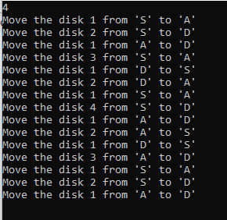
OUT PUT AND EXECUTION

Slide 15
THE REAL MOVES OF THE DISKS

Slide 16
Time And Space Complexity
Time Complexity: -
if we assume n as number of discs Then The time complexity is O(2^n), because that is the number of iterations done in the only loops present in the code, while remaining code run in constant time
Space Complexity: -
The space complexity can be split up into two parts:
The "towers" themselves (stacks) have a O(n) space complexity
The auxiliary space has a O(1) space complexity as there are no other vectors, and the call stack has a fixed size (no dynamic recursion) So the overall space complexity is O(n).

Slide 17
PROJECT-2
THE 4-QUEENS PROBLEM

Slide 18
Description
N Queen’s problem is the puzzle in which n-queens are to be placed on a n*n chess board such that no two queens are in the same row, column or diagonal.
This problem is solved by using the back tracking.

Slide 19
ALGRORITHM
STEP 1: - START
STEP 2: - Place the queens col­umn wise, start from the left most column
STEP 3: - If all queens are placed: return true and print the solu­tion matrix. Else Try all the rows in the cur­rent column.
STEP 4: -Try all rows in the current column. Perform the following steps:
a) if the queens can be placed safely in this row, then mark the (row, column) as part of the solution and recursively check if the queen is perfectly placed or not.
b) Place queen in (row, column) if leads to the solution then
return true.
c) if queen placed doesn't lead to solution, then use backtrack and go to step a) to try other probabilities
STEP 5: - If all rows have been tried and nothing worked, return false.
STEP 6: - STOP

Slide 20
Time and Space Complexity
Time Complexity: -
The QUEEN method takes O(N) time as it iterates through our array every time.
For each invocation of the place method, there is a loop which runs for O(N) time.
In each iteration of this loop, there is QUEEN invocation which is O(N) and a recursive call with a smaller argument.
If we add all this up and define the run time as T(N). Then T(N) = O(N) + N*T (N-1)
1). If you draw a recursion tree using this recurrence, the final term will be
something like n^3+n!0(1). By the definition of Big O, this can be reduced to O(n!)
running time.
Space complexity:
For this algorithm it is O(N). The algorithm uses an auxiliary array of length N to store just N position

Slide 21
CODE
#include<stdio.h> // to use inbult functions like printf and scanf
#include<math.h> // to use the matmatical functions like squ and abs
int a[100],count=0; // globle varibles
int place(int pos) // subfunction to keep the queen position
{//place function starts
int i; // lookle varible to controle the loop
for (i=1;i<pos;i++)// for loop starts
{
if((a[i]==a[pos])||((abs(a[i]-a[pos])==abs(i-pos)))) // checking the condition whather
// // we can place the queen at that position or not
return 0;// no need to return any thing
}
return 1;
}//place function ends

Slide 22
void print_sol(int n) //to print the matrix
{//print sol function starts
int i,j; // loop controle variables
count++;// to count the solutions
printf("\n\nSolution #%d:\n",count); //printing the count
for (i=1;i<=n;i++) //printing the solution matrix
{
for (j=1;j<=n;j++)
{
if(a[i]==j)
printf("Q\t");
else
printf("*\t");
}
printf("\n");
}
}//print sol function ends

Slide 23
void queen(int n) //queen function starts
{ // back tracking
int k=1; // seting the queen on the top left that is at the 1 part of the array
a[k]=0;
while(k!=0) //forming the loop to repeat the steps untile k not = 0
{
a[k]=a[k]+1;// moving the place of the queen
while((a[k]<=n)&&!place(k)) // the loop will be repeat until the queen is placecd safe
a[k]++; // increment the k value
if(a[k]<=n) //checking erather the k value is less than or equal to the entered n value
{
if(k==n) // if the k value is equal to n then print the solution
print_sol(n);
else
{
k++; //else incremnt the k value
a[k]=0;
}
} else //if the queen is not safe we reduse the k value
k--;
}
}// queen function ends

Slide 24
void main()
{// main function starts
int i,n;
printf("Enter the number of Queens\n");
scanf("%d",&n);
queen(n);
printf("\nTotal solutions=%d",count);
}// end of the main function

Slide 25
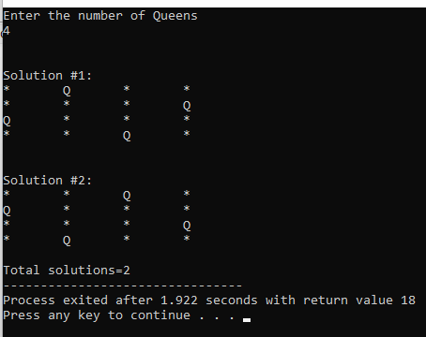
OUT PUT AND EXECUTION

Slide 26
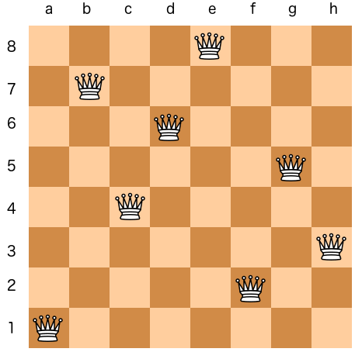
BACK TRICKING AND GETTING SOLUTION OF THE QUEEN

Slide 27
COMPARATION BETWEEN THE TWO PROJECTS
STACK is the most preferred data structure for solving the Tower of Hanoi problem as we have to access the top disk of the tower every time for checking with some condition statement or to move the disk from the top of tower to another tower or the other way around, as stack always keep track of top element and follows LIFO (Last In First Out) principle, Due to this stack proves to be the efficient data structure over here.
ARRAY is the preferred data structure for solving the 4-queens problem as we have to perform multiple backtracking, ARRAY proves to be the efficient data structure for recursive calls and backtracking process.

